Slide 1

Loan Default Prediction Project
Data Science Internship – Finance ML Project
Presented by: Ibrahim Fahd Bindawod

Slide 2
Agenda
Problem Statement
Objective
Data Overview
Data Preparation
EDA Findings
Models Built
Model Evaluation
Feature Importance
Key Findings from Model
Business Recommendations
Conclusion

Slide 3
Problem Statement
In the financial sector, lenders must assess the creditworthiness of borrowers before approving loans. Identifying potential defaulters is crucial to minimizing financial losses and maintaining a healthy lending portfolio.

Slide 4
Objective
Develop machine learning models to classify borrowers into defaulters and non-defaulters based on historical financial and demographic data.

Slide 5
Data Overview
Import data:
Total Records: 5000
Total Columns: 17
Target variable:
'loan.csv’
default_status

Slide 6
Data Preparation
Cleaning steps
Dropped ID and date columns.
Imputed missing values (Median for numerical, mode for categorical).
Encoded categorical variables using Label Encoding.
Scaled numerical features using StandardScaler.
Load Data
Clean Data
Scale Features
Encode Variables

Slide 7
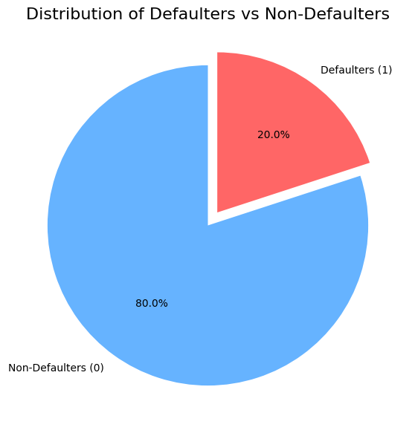
EDA Key Findings
Key Observations:
Majority of customers are non-defaulters.
Higher credit scores correlate with non-default.
High-interest loans tend to have higher defaults.
Certain employment types show higher default rates.

Slide 8
Models Built Why choosing these models?
Logistic Regression
A baseline model
Easy to interpret
Best for linearly separable data
Random Forest Classifier
Handles non-linear relationships.
Reduces overfitting via ensemble of decision trees.
Handles categorical and numerical features well.
Support Vector Machine (SVM)
Very effective in high-dimensional spaces.
Well-suited for binary classification problems.
Sensitive to feature scaling, which has been handled.

Slide 9
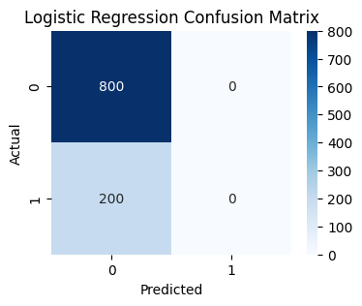
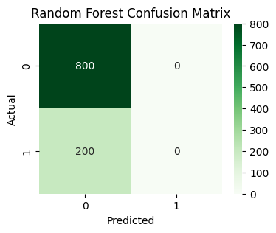
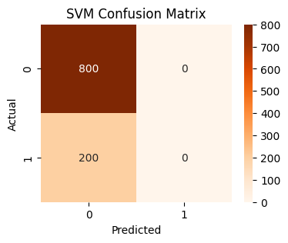
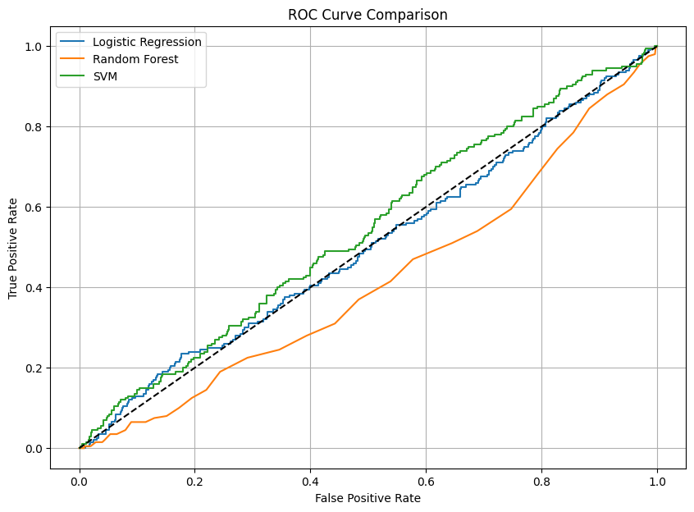
Model Evaluation and Comparison Logistic Regression vs Random Forest vs SVM
AUC (Defaulter) | F1-Score (Defaulter) | Recall (Defaulter) | Precision (Defaulter) | Accuracy | Model
0.5014 | 0.00 | 0.00 | 0.00 | 80% | Logistic Regression
0.4145 | 0.00 | 0.00 | 0.00 | 80% | Random Forest
0.5417 | 0.00 | 0.00 | 0.00 | 80% | SVM

Slide 10
Model Evaluation and Comparison Logistic Regression vs Random Forest vs SVM
key observations :
Each model achieved 80% overall accuracy by primarily predicting non-defaulters, due to class imbalance.
None of the models successfully predict defaulters (Precision/Recall for Defaulters = 0.00).
The dataset is imbalanced (very few defaulters), causing models to ignore minority class (Defaulters).
** The high imbalance between non-defaulters and defaulters caused models to predict only the majority class. Future models may benefit from class balancing techniques like SMOTE (oversampling) or adjusting class weights.

Slide 11
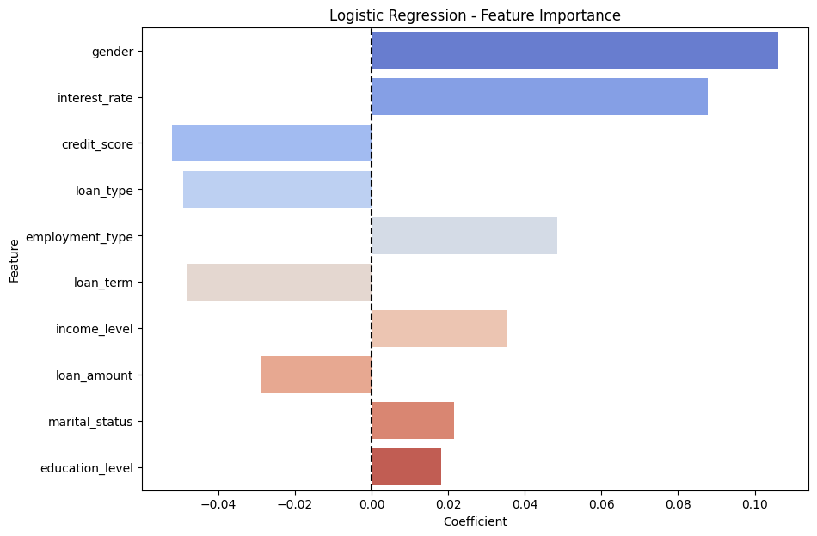
Features Importance Logistic Regression
Gender and Interest Rate have the highest positive impact on default risk.
Credit Score and Loan Type have the strongest negative impact.
Education Level and Marital Status have minimal influence.

Slide 12
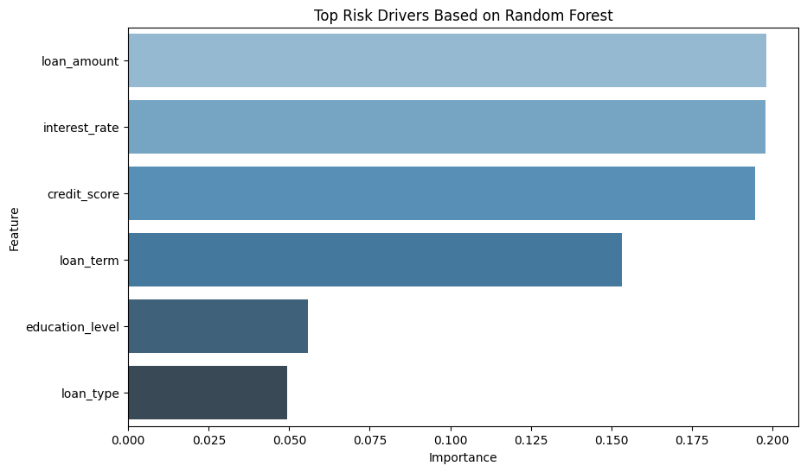
Features Importance Random Forest
Loan Amount, Interest Rate, Credit Score are top predictors.
Loan Term and Education Level also have noticeable effects.

Slide 13
Key Finding from Models Logistic Regression and Random Forest
Credit Score: Strongest protective feature. Higher scores = lower default risk.
Interest Rate: Increases risk of default.
Employment Type: Certain employment types are riskier.
Loan Type: Certain loan types (likely secured ones) lower risk.
Loan Term: Longer loan terms slightly reduce risk.
Gender, Income Level, Marital Status, Education Level:
Minor but noticeable influences.
Should be considered with care (especially gender, due to ethical/legal issues).

Slide 14

Strategic Business Recommendations
Tighten Credit Score Cut-offs
Action: Raise minimum acceptable credit score thresholds for approving loans.
Why: Higher credit scores are consistently linked to lower default risk.
Impact: Reduce bad loans while maintaining good customers.
Review Interest Rate Policies
Action: Monitor high-interest-rate loans more closely.
Why: Customers with higher interest rates have higher chances of defaulting.
Idea: Offer slightly lower rates to good credit customers to attract safer borrowers.

Slide 15
Strategic Business Recommendations
Profile High-Risk Employment Types
Action: Identify which employment types (e.g., temporary, gig workers) have higher default rates.
Why: Certain unstable employment types lead to greater risk.
Impact: Adjust risk models or require more documentation (e.g., income proof).
Focus on Loan Type Differentiation
Action: Prefer secured loans (like home loans) over unsecured ones (like personal loans) in higher-risk cases.
Why: Loan type plays a significant role in risk reduction.
Use Longer Loan Terms Carefully
Action: Offer slightly longer repayment terms for borderline applicants (medium risk).
Why: Longer terms slightly ease repayment burden, reducing defaults.

Slide 16

Business Recommendations Summary
Increase minimum credit score for loan approvals.
Monitor high-interest loans more closely.
Adjust risk models for certain employment types.
Prioritize secured loan types when possible.
Offer longer terms to medium-risk profiles to ease repayment.

Slide 17
Conclusion
Machine learning models can help classify defaulters accurately.
Focus on credit score, interest rate, and employment type for stronger risk control.
These models provide valuable decision support for loan approval strategies.

Slide 18
Thank you for Lasting

